Slide 1
Cooking Up a Plan
Roger Liu
Stephen Chen
Task Planning for the Game Overcooked

Slide 2
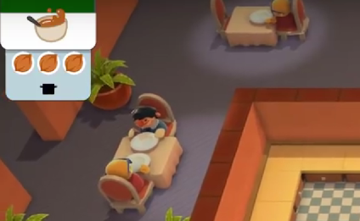
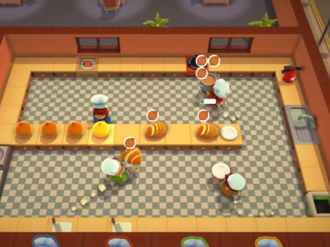
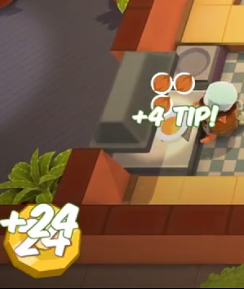
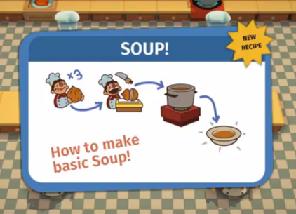
What is Overcooked?
Overcooked is a cooperative cooking game
Players control chefs and prepare meals for incoming orders in real-time.
Creating a meal following involves a series of steps.
Completing meals faster rewards more points.
Complete Meals
Follow Recipes
Get Orders
Organize Tasks

Slide 3
Related Work
Graph Planning
Kamel and Syed. Task Decomposition and Plan Generation in Multiagent Domains.
Spitz and Requicha. Multiple-Goals Path Planning for Coordinate Measuring Machines.
Machine Learning
Arai et al. Mutli-agent Reinforcement learning for Planning and Scheduling Multiple Goals.
Kawakami and Kakazu. A Study on Robot Task Planning Problems in Multiagent Environments.
Other
Kaelbling and Lozano-Perez. Hierarchical Task and Motion Planning in the Now.
Wurm et. al. Coordinating heterogeneous teams of robots using temporal symbolic planning.
Wang et al. Hierarchical Task Planning for Multiarm Robot with Multiconstraint.

Slide 4
Approach
Create a simplified version of Overcooked as our test environment (using Unity game engine).
Use symbolic planning to have a single agent process a single order.
Use waypoint planning to handle multiple orders at a time.
Online planning
Handle orders coming in at different times
Handle the case when there are no outstanding orders
Handle free time during single orders
Potential Extension: Run a centralized, multi-agent planner for 2 agents

Slide 5
Metrics of Success
Speed of computing viable plans
Quality of the plan
Look at reward earned
Compared to optimal
Compared to human players
In the case of 2 agents, can the planner improve its score in a significant way

